Slide 1

Machine Learning Project-1
By,
HARSHINI PERUMAL

Slide 2
CONTENTS
ABSTRACT
OBJECTIVE
INTRODUCTION
METHODOLOGY
CODE
CONCLUSION

Slide 3
ABSTRACT
This project provides a practical demonstration of how machine learning techniques can be applied to address a real-world problem.
This project focuses on developing a machine learning model to classify emails as spam or ham (non-spam). The model utilizes a combination of text preprocessing techniques to transform raw text data into a numerical representation suitable for machine learning algorithms. A Logistic Regression model is then trained on the processed data and evaluated on a held-out test set.

Slide 4

OBJECTIVE
To develop and evaluate a machine learning model capable of accurately classifying emails as spam or ham.

Slide 5
Introduction
Importance of spam detection:
Improved Efficiency and Productivity: Minimising need to manually sort through mails.
Reduced Clutter :Spam emails clog inboxes wasting user’s time
Enhanced Security: Spam filters act as a crucial line of defense against these attacks, protecting users from potential identity theft and financial loss.

Slide 6
Importance of Logistic Regression:
Logistic Regression is specifically designed for classifications.
This project aims at recognizing ham and spam mail which involves classifying them into two separate categories.
Hence, the method of Logistic Regression is apt here.

Slide 7
METHODOLOGY
Dataset:
The dataset used for this project is the “spam_ham_dataset.csv.zip” from Kaggle.com
Link of the source is mentioned below:
https://www.kaggle.com/datasets/venky73/spam-mails-dataset

Slide 8
Data Preprocessing
TOKENIZATION: This involves splitting text data into words separated by comas.
Stemming: Reducing words to their root or base form to improve generalization (e.g., "running" to "run").
Lemmatization: Removed common stop words (e.g., "the," "a," "is") that do not carry significant semantic information.

Slide 9
Feature Engineering
Vectorization: Transforming the text data into a numerical representation for the model to easily interpret

Slide 10
Model Building
Model Selection: A Logistic Regression model was chosen for its suitability for binary classification tasks and its interpretability.
Model Training: The Logistic Regression model was trained on the preprocessed and vectorized training data.

Slide 11
Model Evaluation
Data Splitting: The dataset was split into training and testing sets using a train-test split.
Prediction: The trained model was used to predict the labels of the test data.
Accuracy Assessment: The model's performance was evaluated using accuracy score, which measures the proportion of correctly classified instances.

Slide 12
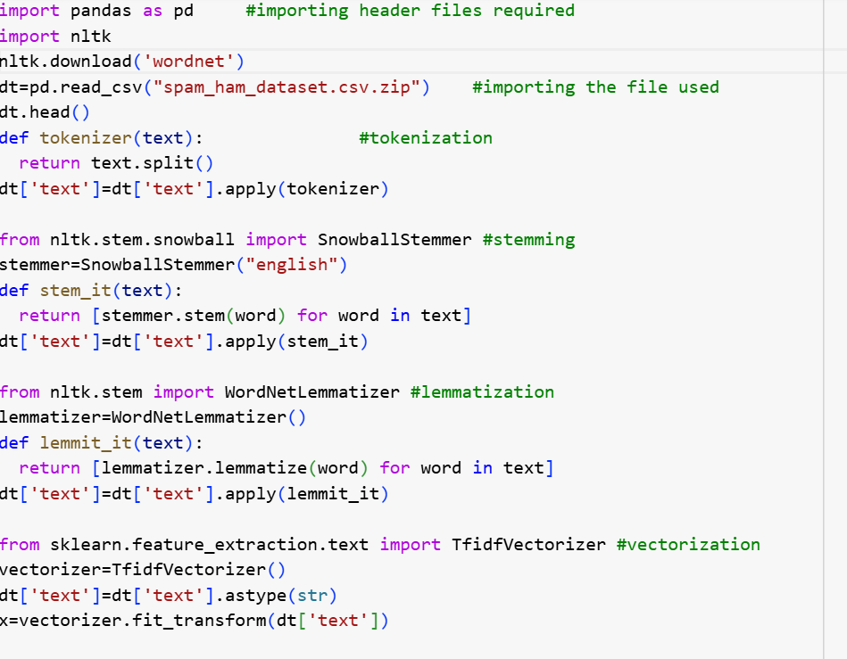
code

Slide 13
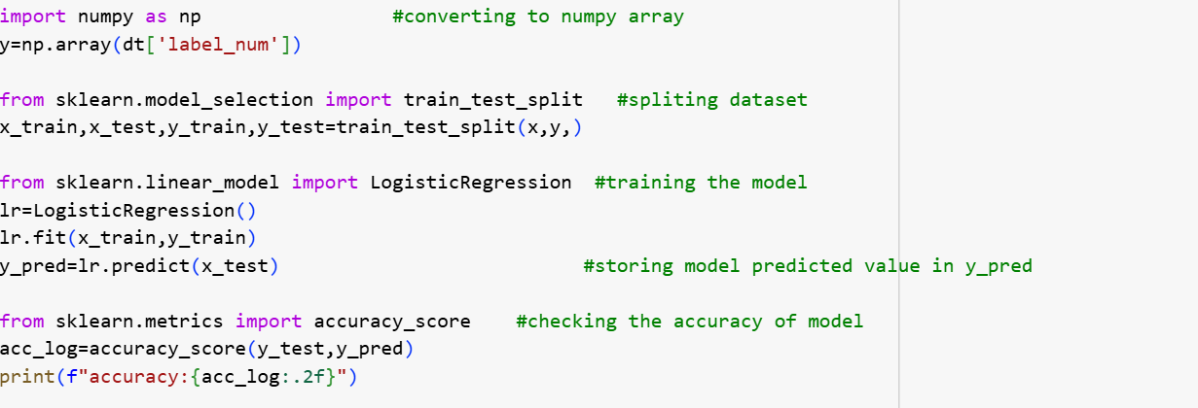
Code link :
https://colab.research.google.com/drive/1UTFJMiwdQ0JDcae7UVodNKrIgHFaSmbt?usp=sharing

Slide 14
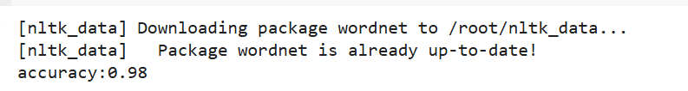
Output
The model achieved a high accuracy of 0.98 i.e. 98% on the test set, indicating its effectiveness in classifying spam and ham emails.

Slide 15
conclusion
The results demonstrate that the developed model can effectively classify spam and ham emails with high accuracy. This project provides a valuable proof-of-concept for applying machine learning techniques to address the real-word challenge of email spam filtering.

